Slide 1

Notes:
We are team AticAtac and our game is TankNite

Slide 2
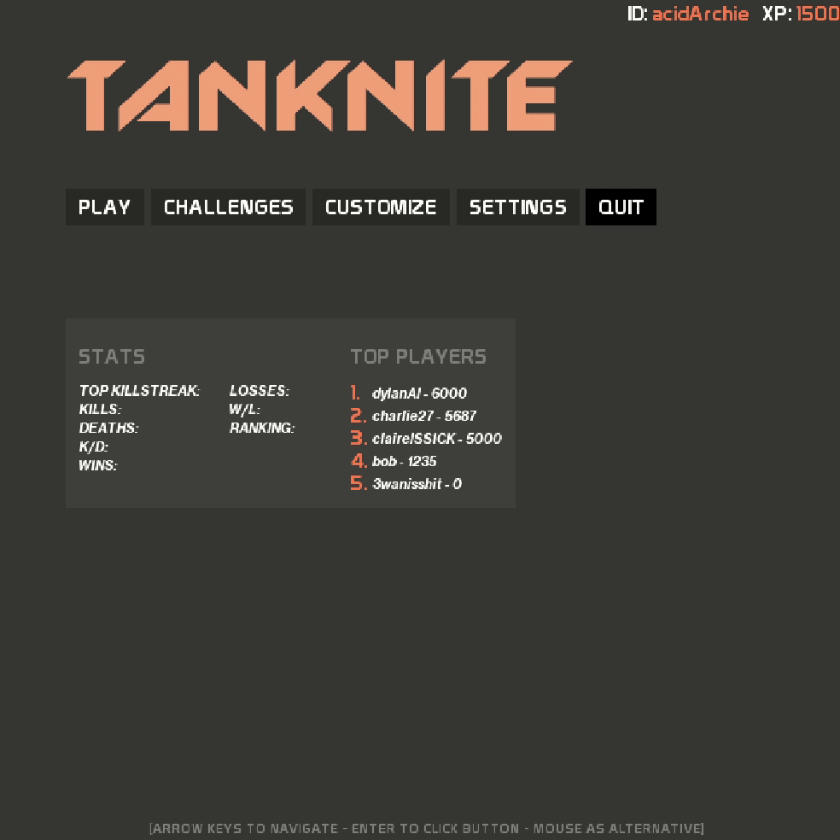
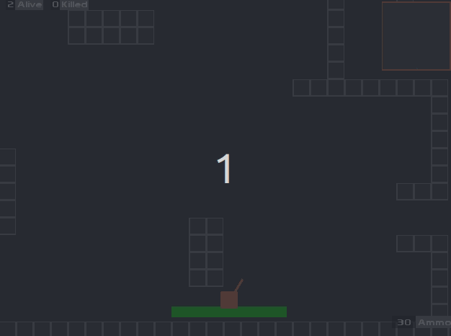
Introduction
Game play - Defeat
Notes:
TankNite is a tank based survival game inspired by tank trouble and fortnite. Tanks compete to be the last tank standing by moving around a maze and shooting others whilst completing challenges and picking up power ups!
Users can also log in to the game at the beginning therefore storing and displaying gameplay data unique to them!
The addition of the cursor as a target increases the theme and makes the user feel even more in control..

Slide 3
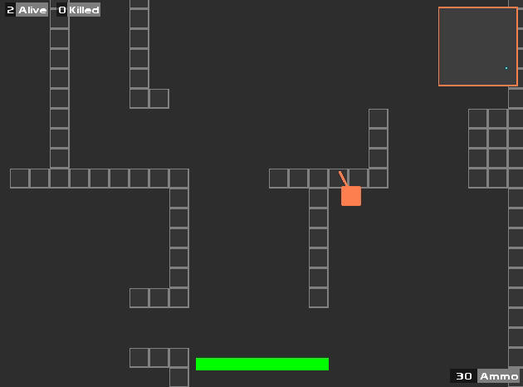
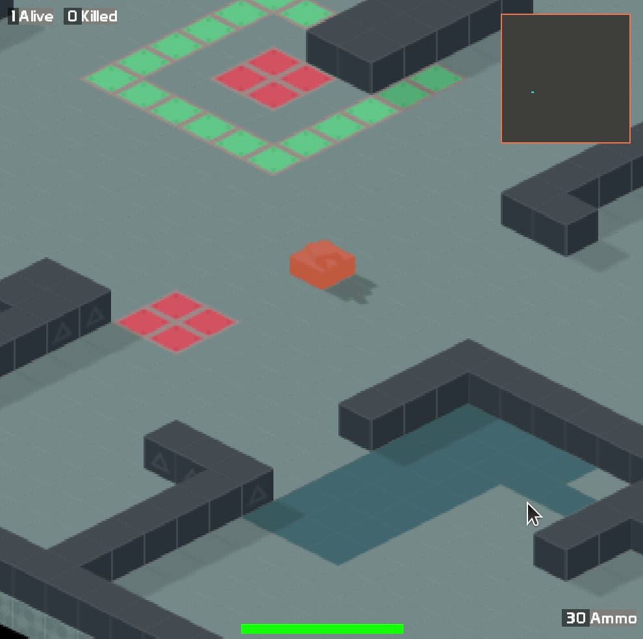


Gameplay
Notes:
When playing the game users have a choice of either a standard, 2D map, or an isometric map. This allows for the choice of a more immersive experience and gives the user a choice. This addition allows for another mode of game play and adds a new experience with different challenges.

Slide 4


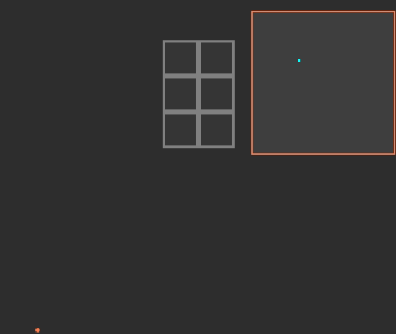




In-game Features
Notes:
Some of our in-game features include:
Complex AI behaviours to enable a fun to play, but difficult to master single player human-like, different states(challenging)
Dyanmic radar so that people can find those that are shooting via a red dot, therefore making a player decide whether to shoot or not as they are then visible/whether to go after shots. Powerup spawns also show on the radar, displaying the type of powerup too, so the user can decide whether to risk trying to get the powerup, and which powerups are worth going out of your way to get.
Customisable options for a more personal experience, users in control of their tank -> tank colour and graphics choice
Compelling audio system to fit the arcade theme and create a better experience, and dramatic moments -> keeps you wanting to play
Come onto those features in more detail later

Slide 5
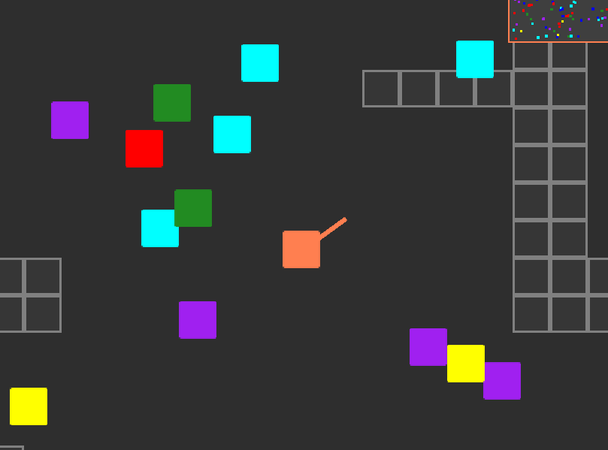

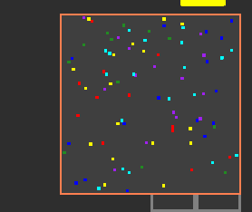







Powerups
Notes:
When playing, tanks can pick up powerups to provide extra functionality. The rate at which these spawn also draws players into one location to attempt to pick up powerups, creating interesting game play!
Ammo: This power up will increase the ammo a tank has by 10 bullets
Speed: This will allow the tank to accelerate up to double the speed of other tanks and move with that speed for 20 seconds
Bullet Spray: Picking up this allows a user to press shift to unleash a bullet spray (16 bullets come out in all directions)
Damage: Increases the damage a tank’s bullet will do (by an increment of 10)
Health: Increases the health of a tank (by 10)
Freeze bullet: This allows the player to rpess control to shoot a special freeze bullet which freezes a tank it hits for a few seconds
Due to our implementations of powerups as entities -> very easy to add more to keep the game fresh to prevent people from being bored

Slide 6
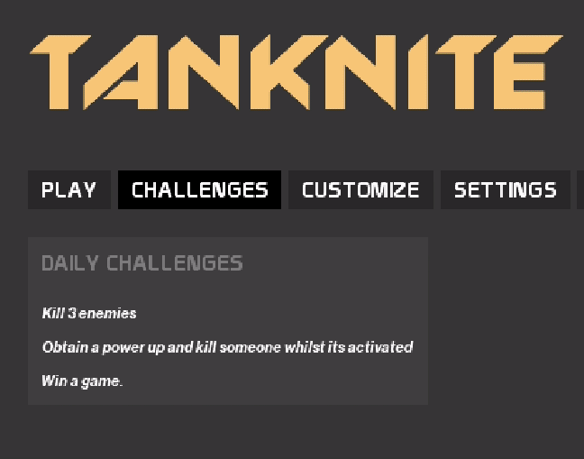
Daily Challenges
DAILY CHALLENGES
Kill 3 enemies
Obtain a power up and kill someone whilst its activated
Win a game.
Notes:
A player has the ability to complete daily challenges.
These are three challenges picked at random each day. At the end of a game any completed challenges are checked for and those points added to your score.
This allows for more playability and promotes daily playing.
Prospect of completing goals has been proven to be addictive to users in gaming.

Slide 7
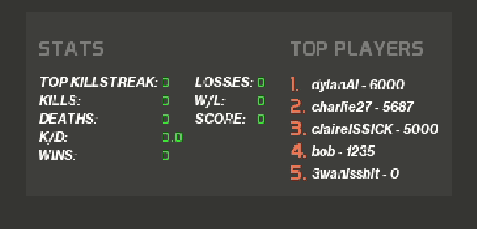
Competitive Play
TOP PLAYERS
dylanAI - 6000
charlie27 - 5667
claireISSICK - 5000
Notes:
The inclusion of top players encourages competitive play and users to return to the game frequently to improve their score, and try to have their name displayed on the menu.
The game also includes statistics like top kill streak and deaths for the player. This is displayed on the menu screen and is unique to the logged in user ID!

Slide 8
Behind the Scenes
Isometric Renderer
Notes:
Isometric Map Rendering

Slide 9
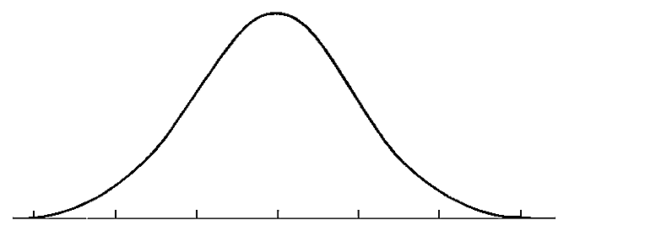
Behind the Scenes
SOUND
Notes:
Sound
Positional sounds which increase as another tank gets closer
When another tank can be seen and shoots, that sound is played
As another tank gets closer their arcade music is played to simulate a radio, this is simulated by the game music increasing as described by the curve
This is done for an interesting feature and as an adrenaline builder as it informs someone that another tank is close by
This adds an interesting dynamic to the game as people can then move away from others

Slide 10
Behind the Scenes
Networking
Database
Server
Client
Client
Client
[Host]
Notes:
Networking/Database
Diagram of how it works

Slide 11
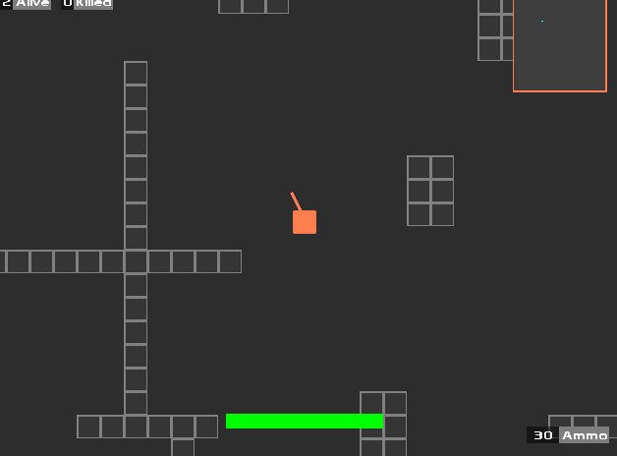
Behind the Scenes
Physics
AI
Notes:
Physics Engine
The physics is calculated using collision boxes for all of the objects in the game
If the proposed movement would intersect then that is not allowed and the objects collide
This works well for smoother collisions and allowed us to develop a kill log as we used a system of entities. The bullets then know which tank they were shot from and who they shot
The physics also uses the same movement calculations for all tanks, bullets and in 2D or isometric, using position vectors and bearings
This means that they could be easily developed for the future.
AI

Slide 12





Development
Notes:
Various software to increase efficiency and save time:
We used a waterfall model to develop our project as we know our requirements well and its a relatively small project(and more incremental so as not to only test at end of process -> less risky)
Libgdx to help us develop game’s features
GitLab for managing and storing the project, gitKraken to speed up git processes like merging, and standardise our use of git
Gradle for building the project
IntelliJIDEA was used to develop the project more intelligently and efficiently, helpful for debugging and suggestions it offers
Ideas for future development? - easy to build onto and add more or flesh out current ones, solid software design -> very easy to adapt code and add new features
Isometric! Can take the game a different way to more advanced graphics, allows them to play advanced or stick to retro arcade style, whichever they prefer

Slide 13

Notes:
ANy QuEsTiOnS?

